Slide 1


Megha S
December 15, 2021

Slide 2

Outline
Executive Summary
Introduction
Methodology
Results
Conclusion
Appendix

Slide 3
Executive Summary
Data is collected from SpaceX Wikipedia page using the SpaceX public API. Created a new feature called ‘Class’ which classifies the landings as successful or failure. SQL, different visualization tools, folium maps and dashboards are used to explore data.
4 machine learning models are used to perform predictive analysis on landings. The best model is selected after using hyperparameter tuning and GridSearchCV.
Decision Tree performed the worst with accuracy of 77.8% while all the other models performed the same with an accuracy of 83.3%.

Slide 4
Introduction
Background
Space programs are now being commercialized making it possible for anyone and everyone to be able to fly to space.
This has been made possible especially by the low cost of the SpaceX Falcon9 rocket ($62 million USD) as compared to the other providers ($165 million USD)
The lower cost accredited to the SpaceX ability to reuse first stage.
An analysis for a hypothetical space company is done to present as a competitor of SpaceX
Problem
Training machine learning models to predict successful landing and recovery of stage 1.

Slide 5


Slide 6
Methodology
Executive Summary
Data collection methodology:
Integration of BeautifulSoup4 and SpaceX API for web scrapping data from SpaceX Wikipedia page
Perform data wrangling
Normalization of data to remove variance. Imputation to replace missing value. Classifying the successful landings as successful while all other landings are classified as unsuccessful
Perform exploratory data analysis (EDA) using visualization and SQL
Perform interactive visual analytics using Folium and Plotly Dash
Perform predictive analysis using classification models
Data is normalized and imputed. Parameter grid is defined and tuned using GridSearchCV with 10 folds

Slide 7
Data Collection
The data is scrapped and collected from SpaceX Wikipedia page using the SpaceX public API.
BeautifulSoup library in python allows to parse the data and get the actual contents from the json file obtained by the SpaceX API.
Defined functions to get the Booster Version, Launch Site, Payload Data and Core Data

Slide 8
Data Collection – SpaceX API
GitHub Link : https://github.com/elkang71/IBM-Applied-Data-Science-Professional-Certificate/blob/main/Course%2010%20%E2%94%80%20Applied%20Capstone%20with%20Python/Data%20Collection%20API.ipynb
Step 1
Request SpaceX API
Step 2
Extract JSON and convert it to Pandas DataFrame
Step 3
Extract and store Booster Version, Launch Sites and Payload Data into lists
Step 4
Create Dictionary from the lists extracted in Step 3
Step 5
Convert the dictionary obtained in Step 4 to a pandas DataFrame
Step 6
Filter the data to get Falcon9 data only
Step 7
Calculate the mean of PayLoad Mass
Step 8
Replace the missing values in Payload Mass column using the mean calculated in Step 7

Slide 9
Data Collection - Scraping
Github Link : https://github.com/elkang71/IBM-Applied-Data-Science-Professional-Certificate/blob/main/Course%2010%20%E2%94%80%20Applied%20Capstone%20with%20Python/Data%20Collection%20with%20Web%20Scraping.ipynb
Step 1
Request Wikipedia SpaceX HTML
Step 2
Use BeautifulSoup4 library to parse the request data
Step 3
Loop over the tables and extract relevant data into lists
Step 4
Create Dictionary from the lists extracted in Step 3
Step 5
Convert the dictionary obtained in Step 4 to a pandas DataFrame

Slide 10
Data Wrangling
Calculate number of launches on each site, number of occurrences of each orbit and number + occurrence of mission per orbit type
Create training column ‘Class’ with successful landings mapped to 1 and unsuccessful landings mapped to 0
Mapped features with ‘True’ as string to 1 and all the others to 0
GitHub https://github.com/elkang71/IBM-Applied-Data-Science-Professional-Certificate/blob/main/Course%2010%20%E2%94%80%20Applied%20Capstone%20with%20Python/Data%20Wrangling.ipynb

Slide 11
EDA with Data Visualization
Use scatter plot to observe the relationship of Payload vs. Outcome, Payload vs. Launch Site, Outcome vs. Orbit and Payload vs. Orbit.
The goal is to observe the correlation between two variables each time for which scatter plot works exceptionally well and therefore is used
Use bar chart to visualize success rate of each type of orbit
Bar charts work well with categorical data hence bar chart is used
Line chart is used to observe relationship between success rate and year
Line chart is used as it can show formation of trends
GitHub https://github.com/elkang71/IBM-Applied-Data-Science-Professional-Certificate/blob/main/Course%2010%20%E2%94%80%20Applied%20Capstone%20with%20Python/EDA%20with%20Visualization.ipynb

Slide 12
EDA with SQL
Data is loaded into the IBM DB2 Database
Queried the data by SQL integration in Python
Queries involved exploring the data to get more information about
Launch Sites Names
Mission Outcomes
Payload sizes of customers
Payload sizes of booster versions
Landing Outcomes
GitHub https://github.com/elkang71/IBM-Applied-Data-Science-Professional-Certificate/blob/main/Course%2010%20%E2%94%80%20Applied%20Capstone%20with%20Python/EDA%20with%20SQL.ipynb

Slide 13
Build an Interactive Map with Folium
Built interactive maps using Folium library
Added information about Launch sites, successful and unsuccessful landings and locations such as highways and railways located near by
Circle markers are added for launch sites and the distance lines are added to show the distance between highway and coastline
The objects added help better understanding the reason for the launch site locations along with being able to better visualize the successful landings corresponding to the locations
GitHub https://github.com/elkang71/IBM-Applied-Data-Science-Professional-Certificate/blob/main/Course%2010%20%E2%94%80%20Applied%20Capstone%20with%20Python/Launch%20Sites%20Locations%20Analysis%20with%20Folium.ipynb

Slide 14
Build a Dashboard with Plotly Dash
Dropdown menu, pie chart, interactive slider and line charts are added
The dropdown menu is added to filter and show the total number of successful launches for launch sites.
Pie chart helps visualize the results based on dropdown menu options for better understanding and interpretation
The slider allows to adjust the payload between 0 to 10,000 kg
The scatter plot helps visualize the correlation between the payload and the launch sites
GitHub https://github.com/elkang71/IBM-Applied-Data-Science-Professional-Certificate/blob/main/Course%2010%20%E2%94%80%20Applied%20Capstone%20with%20Python/spacex_dash_app.py

Slide 15
Predictive Analysis (Classification)
GitHub https://github.com/elkang71/IBM-Applied-Data-Science-Professional-Certificate/blob/main/Course%2010%20%E2%94%80%20Applied%20Capstone%20with%20Python/Machine%20Learning%20Prediction.ipynb
Step 1
Separate the features (X) and the target label (Y)
Step 2
Data is split into train and test sets with 75% as train and 25% as test set
Step 3
The train and test sets were scaled to normal distribution
Step 4
The models are evaluated on accuracy score
Step 5
Parameters were defined for each model to help find the best set of parameters
Step 6
GridSearchCV with 10 folds is used to tune the models with the parameters defined
Step 7
Accuracy score and confusion matrix are obtained on the test set using best parameters found
Step 8
The best model is found based on the accuracy score on the test set

Slide 16
Results
Exploratory data analysis results
As the number of flights increase, the success rate increased
The payload is an important factor : higher payloads decrease the chances of success
As years passed, the success rate increased
The first successful landing came 5 years later in 2015
Interactive analytics demo in screenshots
CCAFS SLC-40 launch site has the shortest distance to the coastline of 0.86 KM
KSC LC-39A (center) in Florida has the most successful launches
Predictive analysis results
Data collected in terms of features can be successfully used to predict the landing outcome
Logistic Regression, SVM and KNN were able to achieve an accuracy of 83% on the test set
More data is needed to improve the performance of the machine learning models and to improve results

Slide 17


Slide 18
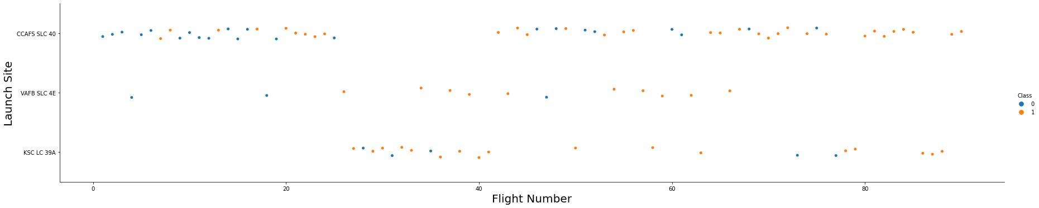
Flight Number vs. Launch Site
The blue dots represent the unsuccessful landings while the orange dots represent the successful landings. The number of unsuccessful landings are quite high in the beginning, but as there are more flights (represented by Flight Number on the X-axis) there are more successful landings. The figure also shows that the CCAFS SCL 40 launch site has the most number of launches. VAFB SLC 4E launch site had the least launches and all the launches seem to be a bit further away from each other for it

Slide 19
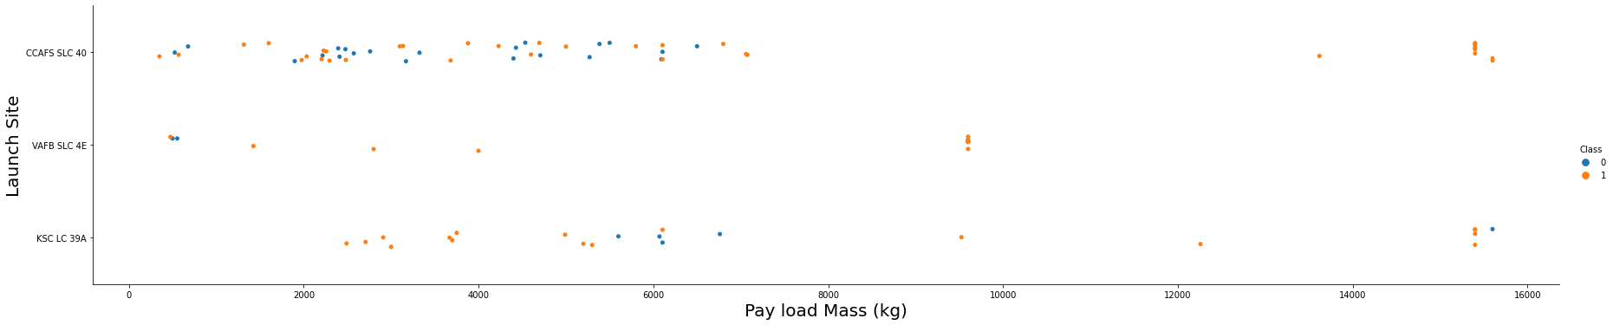
Payload vs. Launch Site
The blue dots represent the unsuccessful landings while the orange dots represent the successful landings. Vast majority of the payloads for CCAFS SCL 40 launch site are under 8,0000 kg. The payloads greater than 8,000 kg are all successful though. Similar is he case for KSC LC 39A except the is one unsuccessful landing for payload greater than 8,000. VAFB SLC 4E launch site has no payload that exceeds 10,000 kg.

Slide 20
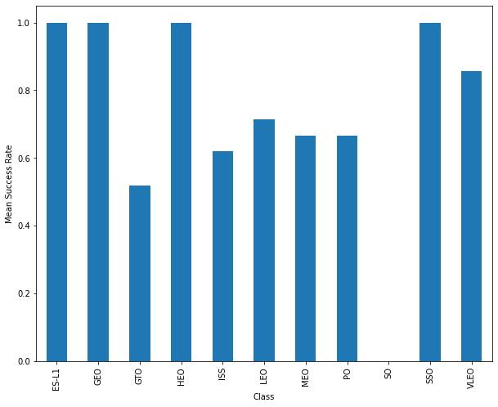
Success Rate vs. Orbit Type
ES-L1, GEO, HEO and SSO all have the highest success rate of 100%
VLEO has the second highest success rate of around 85%
SO does not seem to have any launches
All the others have a success rate lower than 80%
GTO has the lowest success rate of around 55%

Slide 21
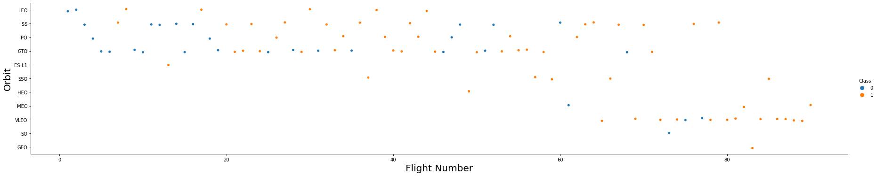
Flight Number vs. Orbit Type
You should see that in the LEO orbit the Success appears related to the number of flights; on the other hand, there seems to be no relationship between flight number when in GTO orbit.

Slide 22
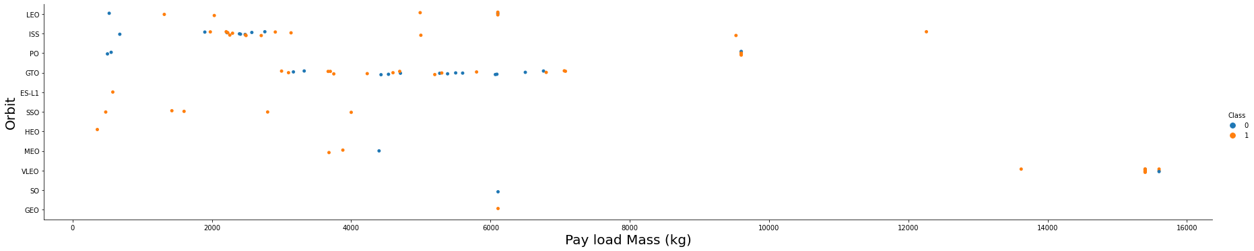
Payload vs. Orbit Type
With heavy payloads the successful landing or positive landing rate are more for Polar, LEO and ISS.
However for GTO we cannot distinguish this well as both positive landing rate and negative landing(unsuccessful mission) are both there here.

Slide 23
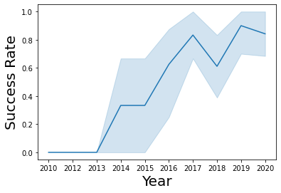
Launch Success Yearly Trend
The trend line shows and upwards trend with the years
As the years progress, the success rate generally increases
The exception to the upward trend is from 2013-2015 when the success rate stays constant and in 2018 when the success rate dips

Slide 24
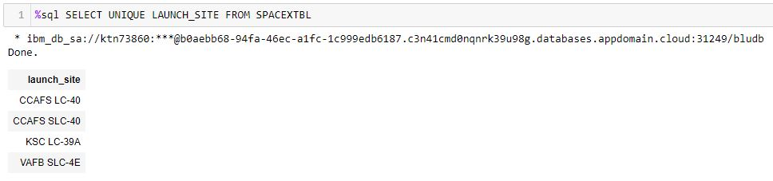
All Launch Site Names
There seem to be 4 unique launch site names
CCAFS LC-40 and CCAFS SLC-40 could very likely be the same launch site with typing error being made at time of entry, however, they could be 2 different launch sites

Slide 25
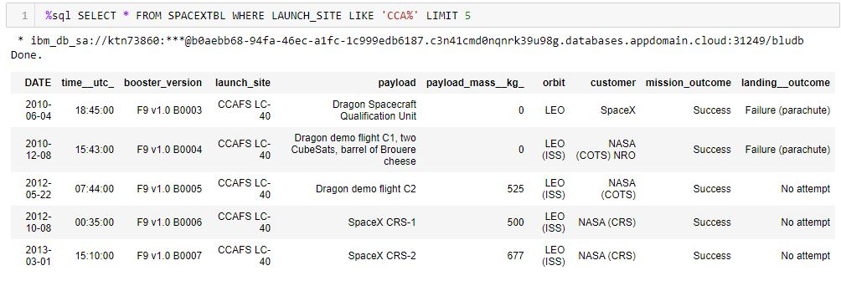
Launch Site Names Begin with 'CCA'
The first launch from CCAFS LC-40 is in the year 2010
The first orbits seem to be LEO orbits
The first five mission outcomes are successful

Slide 26
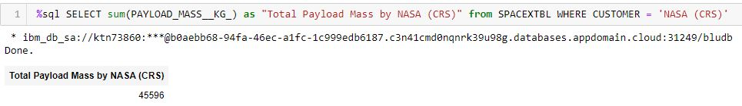
Total Payload Mass
The total payload mass by NASA (CRS) is 45,596 kg

Slide 27
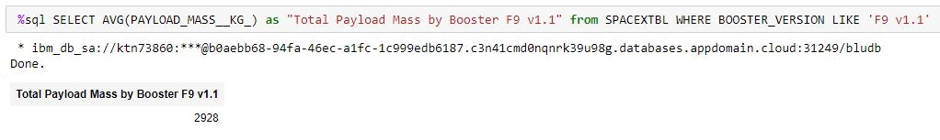
Average Payload Mass by F9 v1.1
The average payload mass by Booster F9 v1.1 is 2,928 kg

Slide 28
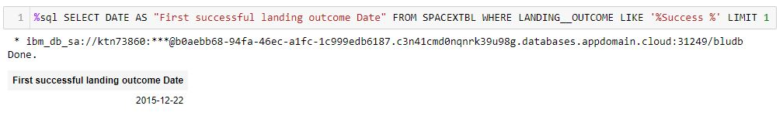
First Successful Ground Landing Date
The first successful landing outcome is on 2015-12-22
This is almost 5 years after the first mission launched which launched in 2010

Slide 29
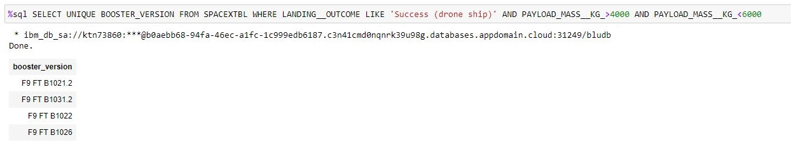
Successful Drone Ship Landing with Payload between 4000 and 6000
There seem to be five booster versions where the landing outcome was successful by a drone ship
All the booster versions are variations of F9

Slide 30
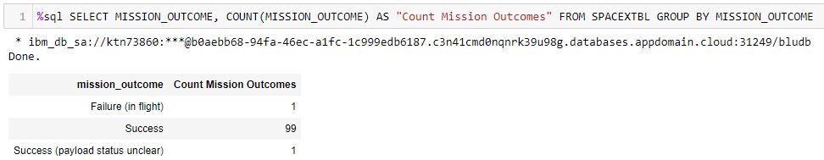
Total Number of Successful and Failure Mission Outcomes
There seem to be only 1 failure and 1 success with payload status unclear
The success rate seems to be 99%

Slide 31
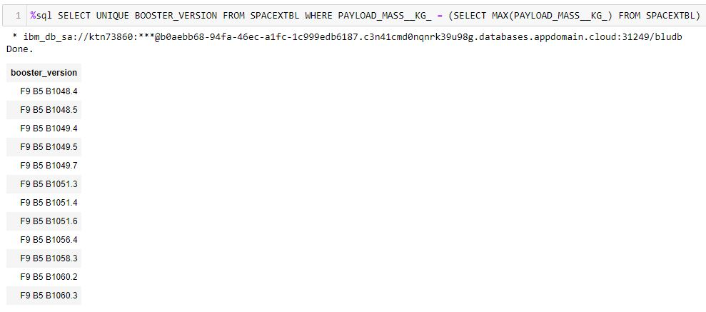
Boosters Carried Maximum Payload
There are 12 booster versions
All the booster versions seem to version of F9

Slide 32
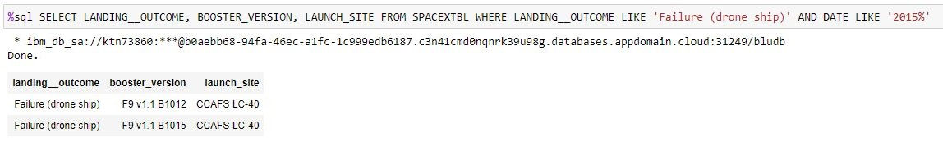
2015 Launch Records
There are only 2 records for year 2015
The landing outcomes seem to be failure on drone ship
Booster version is F9 v1.1
The launch site for both launches is CCAFS LC-40

Slide 33
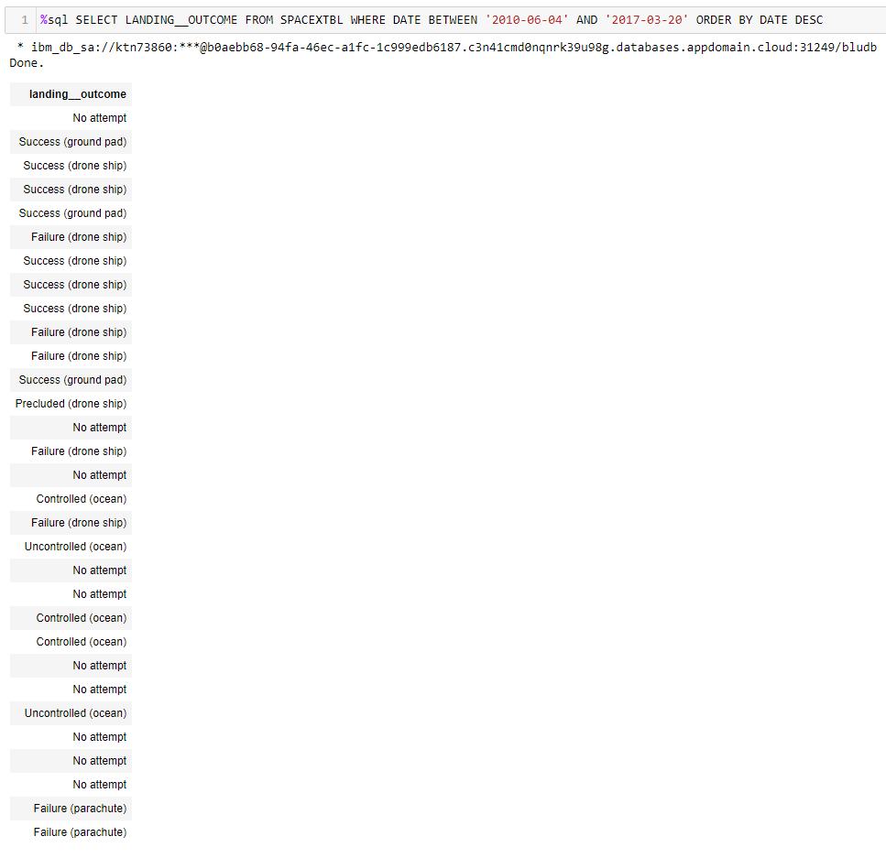
Rank Landing Outcomes Between 2010-06-04 and 2017-03-20
There are 31records between 2010-06-04 and 2017-03-20
Booster version is F9 v1.1
There are 8 records on successful landing
There are 7 records of unsuccessful landing
There are 9 records where no attempt at landing is made

Slide 34


Slide 35
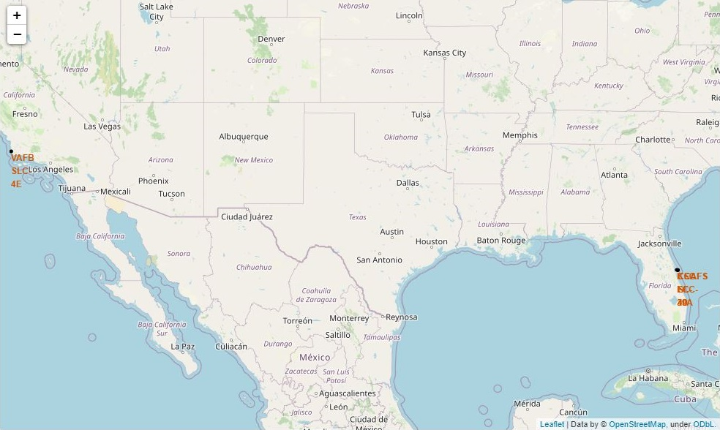
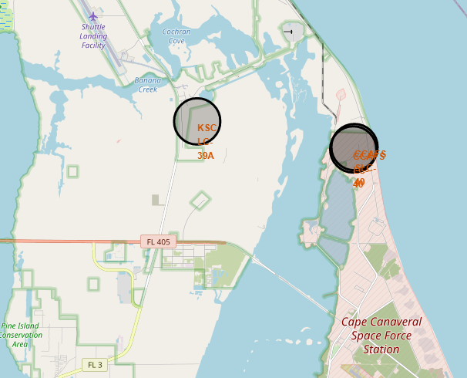
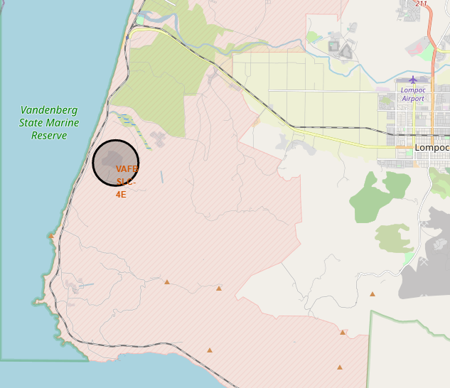
Launch Site Location
There are 3 launch sites
2 are in Florida
1 is in Los Angeles

Slide 36
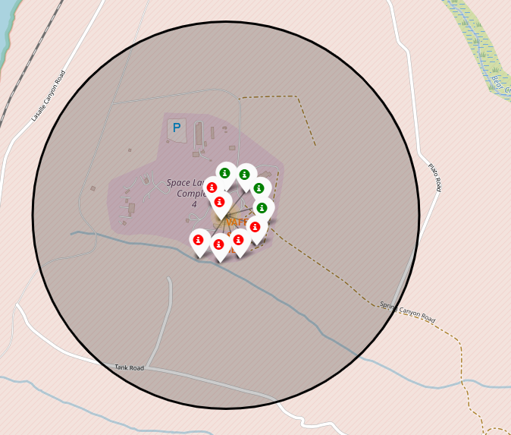
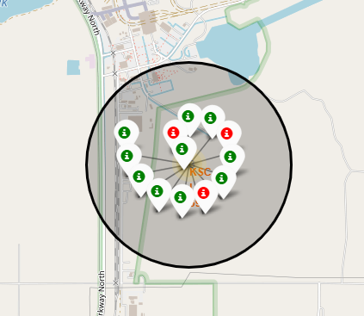
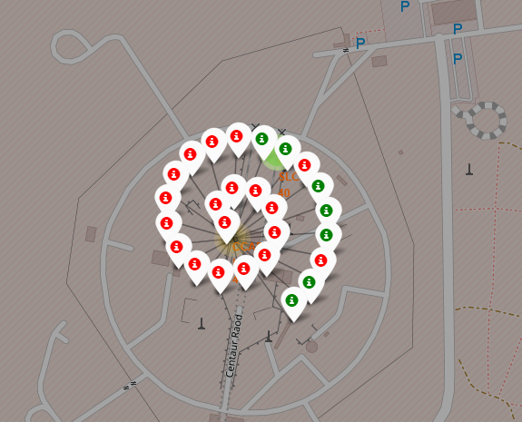
Landing Outcomes for Each Site
CCFAS SLC-40 (right) in Florida seems to have the most launches
VAFB SLC-4E (left) in Los Angeles has comparatively fewer launches
CCFAS SLC-40 (right) has the highest launches with also the most unsuccessful launches (red)
KSC LC-39A (center) in Florida has the most successful launches (green)

Slide 37
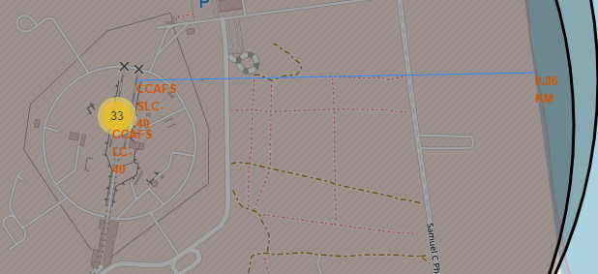
Shortest Distances from Launch Site
The shortest distance from the launch site CCAFS SLC-40 to the coastline is 0.86 KM

Slide 38


Slide 39
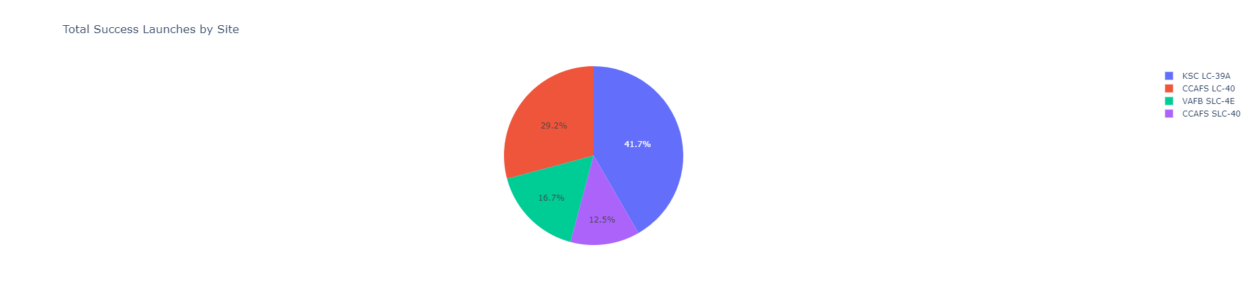
Total Success Launches for All Sites
KSC LC-39A has the highest success rate of 41.7%
CCAFS SCL-40 has the lowest success rate of 12.5%

Slide 40
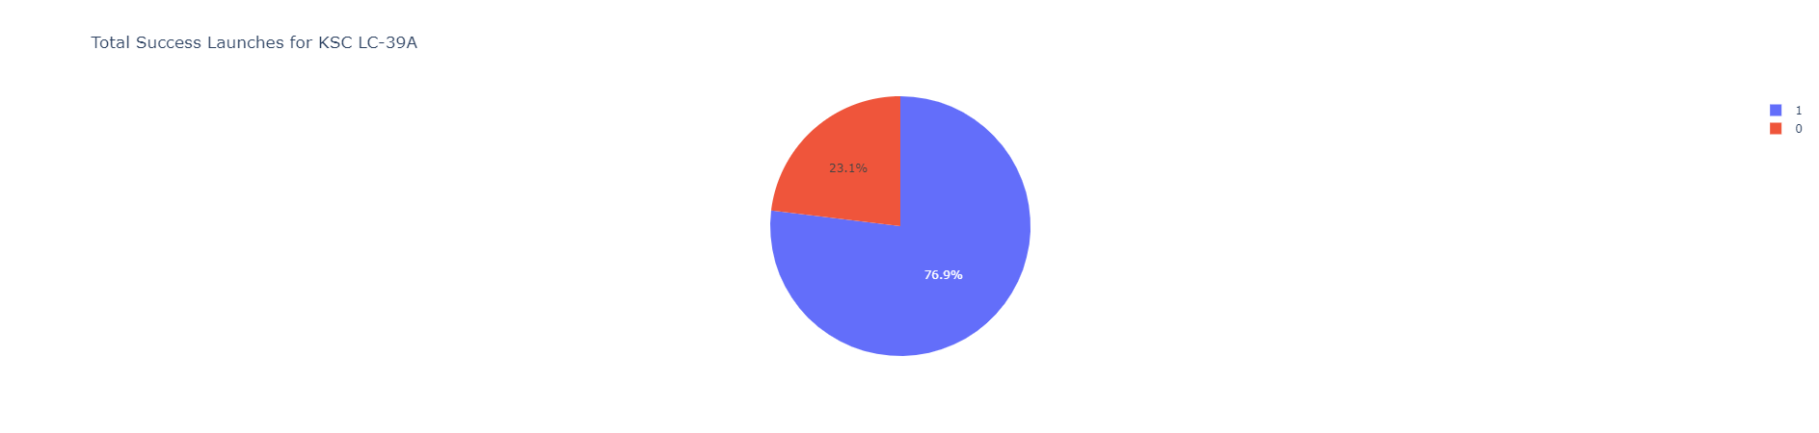
Pie Chart of KSC LC-39A
There are 76.9% successful launches
Only 23.1%R launches were unsuccessful

Slide 41
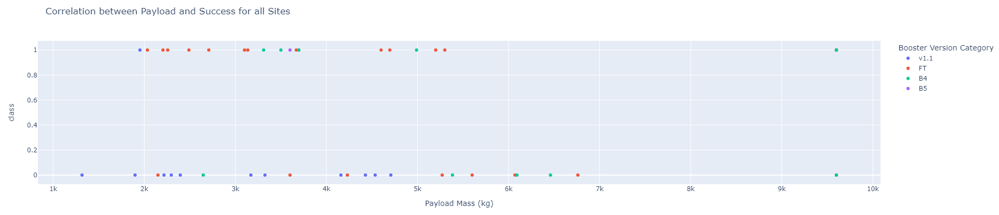
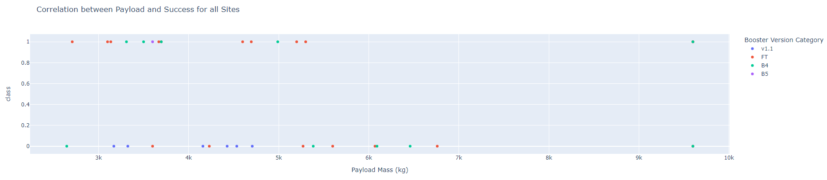
Payload vs. Launch Outcome
Payload vs. Launch outcome for all sites with Payload set to 1,000 kg (top) and Payload vs. Launch outcome for all sites with Payload set to 2,500 kg (bottom)
As the Payload increases, the success rate decreases for all sites

Slide 42


Slide 43
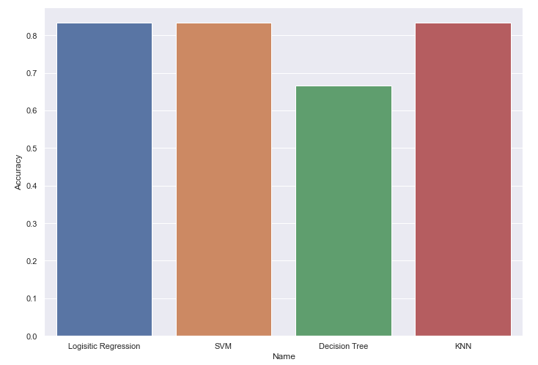
Classification Accuracy
Decision Tree performs the worst on the test set with accuracy of 67%
All the other models perform same with accuracy of 83%
The same accuracy can be attested to the very small test size
Training and testing on more data would be yield better insights and results

Slide 44

Confusion Matrix
There are two classes : did not land (negative) and landed (positive)
From the confusion matrix we see that there are no False Negatives (landed but predicted as did not land)
There are only 3 False Positives (did not land but predicted as landed)
The test data was very small with only 18 samples
The confusion matrix is for Logistic Regression, SVM and KNN as they performed the same

Slide 45
Conclusions
Payload Mass seems to be inversely proportional to the success rate : as the Payload Mass increases the success rate of landing decreases
The site of launch is also vital. KSC LC-39A located in Florida has the highest success rate
As time progressed, the number of flights increases and with that so does the success rate
Features in the collected data can be used to successfully predict the outcome of landing using various Machine Learning algorithms
More data needs to be collected to improve the performance of Machine Learning models

Slide 46
Appendix
Include any relevant assets like Python code snippets, SQL queries, charts, Notebook outputs, or data sets that you may have created during this project

Slide 47


